Slide 1
The benefits and challenges of working in an aged care facility
Maintaining yourself and your enthusiasm in the workplace and What DMT can offer this population

Slide 2
BENEFITS OF WORKING IN AN AGED CARE HOME
Surrounded by a team of people working towards similar goals.
It is a safe/supported place to start working.
It is a gentle and mostly pleasant population to work with.
Your work will make a difference
Your client population is already available and close at hand. i.e. located in one building.
Don’t need to hire or pay for a dance space.
There are work opportunities available and they are paid.
You don’t need to advertise your sessions

Slide 3
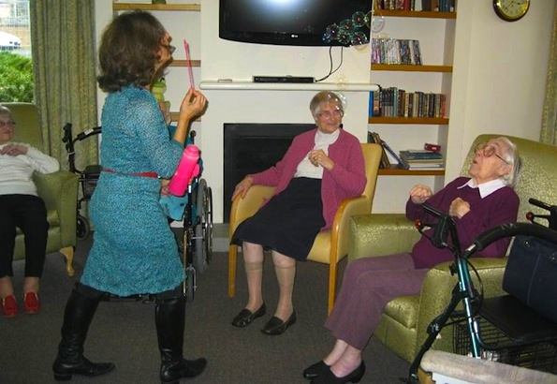

Slide 4
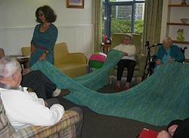

Slide 5
CHALLENGES OF WORKING IN AN AGED CARE HOME
Privacy and creation of an intimate space may be a problem.
Staff may not be aware of breaking boundaries in your session (If you are running a session where some depth is achieved it can be disruptive to have staff entering and leaving the space)
Your dance movement therapy work and its value may not be understood. It may be mistaken for an exercise or dance exercise session so your work is undervalued. (DMT is an art form as well as a therapy)

Slide 6
What do I meet when I enter an aged care home.

Slide 7
What do I meet when I enter an aged care home.
Loss of Context: As an aged client, I’m placed in an environment where I have no connection at a time of my life when it is more difficult for me to make connections

Slide 8
What do I meet when I enter an aged care home.
Loss of Context: As an aged client, I’m placed in an environment where I have no connection at a time of my life when it is more difficult for me to make connections
Individuals with less energy, Restricted movement, Pain, loss of hearing.

Slide 9
What do I meet when I enter an aged care home.
Loss of Context: As an aged client, I’m placed in an environment where I have no connection at a time of my life when it is more difficult for me to make connections
Individuals with less energy, Restricted movement, Pain, loss of hearing.
Institutionalised individuals – it can feel impersonal or at worst dehumanizing.

Slide 10
What do I meet when I enter an aged care home.
Loss of Context: As an aged client, I’m placed in an environment where I have no connection at a time of my life when it is more difficult for me to make connections
Individuals with less energy, Restricted movement, Pain, loss of hearing.
Institutionalised individuals – it can feel impersonal or at worst dehumanizing.
uninterested or disaffected (angry that they are there and therefore generally resistant)

Slide 11
What do I meet when I enter an aged care home.
Loss of Context: As an aged client, I’m placed in an environment where I have no connection at a time of my life when it is more difficult for me to make connections
Individuals with less energy, Restricted movement, Pain, loss of hearing.
Institutionalised individuals – it can feel impersonal or at worst dehumanizing.
uninterested or disaffected (angry that they are there and therefore generally resistant)
individuals who are often deteriorating physically and mentally.

Slide 12
What do I meet when I enter an aged care home.
Loss of Context: As an aged client, I’m placed in an environment where I have no connection at a time of my life when it is more difficult for me to make connections
Individuals with less energy, Restricted movement, Pain, loss of hearing.
Institutionalised individuals – it can feel impersonal or at worst dehumanizing.
uninterested or disaffected (angry that they are there and therefore generally resistant)
individuals who are often deteriorating physically and mentally.
Death of residents

Slide 13
How do I get the clients to want to participate. What would make them want to come? How do I make it relevant for them when they don’t know what dance movement therapy is.

Slide 14
Charm Them
Create an atmosphere to make it appealing
Any suggestions?

Slide 15
EXPERIENTIAL
Walk around your home and select some object with which you can create a circle like shape. This will represent your safe space.
Place some objects (2 or 3) that you are attracted to or love within it.
Sit within your safe space circle and draw or move with the intention of allowing a theme to emerge that will nurture and draw in an elderly group in a hostel. Feel free to use anything you’ve collected or not.

Slide 16
Things that help to Maintain yourself (professional self esteem) and your enthusiasm in the workplace
Liase with the activities coordinator about what her goals for the group are, be onboard and have him/her onboard and supporting your work.
Aged care organisations have to meet Quality Standards set by government and they are regularly audited. Be familiar with the terms used and the Quality Standards that your work can contribute to by doing a bit of research beforehand.
Keep a log. Writing out your goals, session plans, and post-session notes will help you understand the effect of your work and what contribution is taking place. Note the things that work and how they had an effect on particular residents. Some hostels may want you to write up session notes for them.

Slide 17
Have faith that Dance Movement Therapy will contribute positively to these people’s lives.
DMT can offer a sense of expansion and freedom from confinement
Creative visualisation and movement can be used to - Imagine and embody positive experiences that residents can no longer access physically. E.g. skiing; swimming; being out in the bush, or flying like a bird.
A sense of belonging or intimacy can be created in the group.
Through smelling, touching objects, or reconnecting with activities/movements from their past, the client can connect with their past self and have this seen and acknowledged by the therapist.

Slide 18
DON’T FORGET YOURSELF
Refill your own well:- regularly nourish your creative self, by meeting with peers, dancing, dyading, exposing yourself to the arts, attending workshops. Having supervision Etc.

Slide 19
What goals can I focus on for an elderly population
And
how do I achieve them?

Slide 20
Individualising the clients within the group so that they feel they are more than a room number
Method examples:
personal interaction
Highlighting, their movements (by mirroring; reflecting; verbally describing)
Setting goals for a particular person in the group (maybe for 2 people each session)
Get the group to help them extend or achieve their goals.
Highlight something someone is doing well

Slide 21
2. Enlivenment- To “come alive”, have intent and purpose, to become more responsive and expressive.
Method examples:
Through movement (moving makes you feel enlivened)
Personal interaction
Through sound e.g. clients use chopsticks tapping or drumming to Bizet’s Toreaodor
look for association so they become personally involved.
Dance the goal i.e. the dance of intentionality and purpose (opposite to flatness, immobility, death, depression)
Use qualities like rain, wind, thunder to get varying intensity using rubbing of hands, clapping to clapping hard or loud, or chopsticks slow to fast, soft to loud for rain.
Bring out passion/sexuality using tango music\e.g. Piazola ‘s libertango - sexuality can be expressed in the fingertips or the eyebrows

Slide 22
3.Experiencing space differently (mostly indoors in hostel can feel like being in a prison)
Method examples:
Get them to move if able to, in and out of the space one at a time with their walkers, maybe with a scarf dance
With the help of someone mobile, move a piece of material over ther heads so they have to reach to touch it
Their breathing space can change, Shape flow: Bulge and retreat
rise and fall
side to side
Using Laban: Space is about attention to the world
Time is about decision making
Weight is about assertion

Slide 23
What do I include in my report?
Goals
How you got there
Significant moments
What stood out for me
What stood out for the clients
Expressive moments
Take a photo of the session ( with permission) which can also be pinned up on board.
Assess how much they got into e.g. expressiveness or changed their breathing, or had a sense of fun etc.

