Slide 1

Kinesthetic eMpathy and Attunement

Slide 2
What just happened?
Everyone’s movements got bigger, expanded as the musical quality built.
Lyrics motivated the dance, it was suggestive/inviting.
Everybody doing the same thing. Witnessing each other.
Form of interaction-movement
Playful
Many round, flowing movements
Tuning in to a the group’s feeling/tone
Empathy of dance

Slide 3
What does this offer?

Slide 4
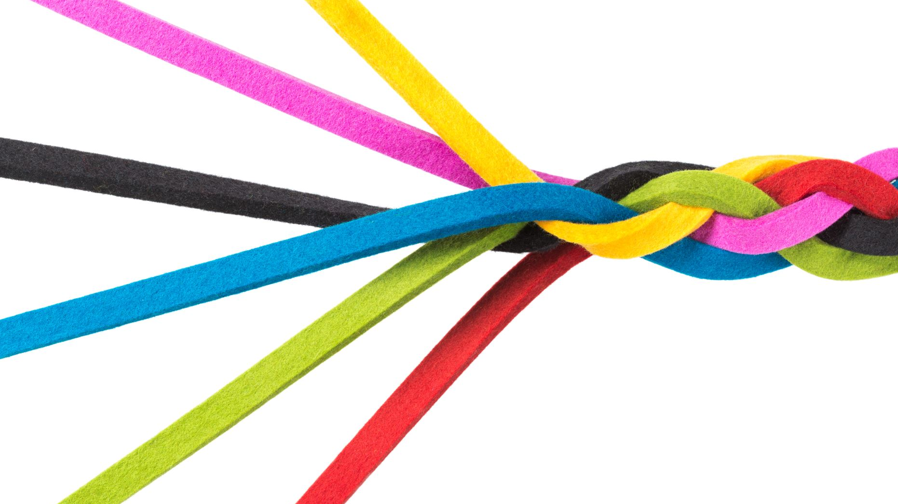
Kinaesthetic Empathy
What is it?
Moving/dancing to the same beat at the same time helps us feel connected.
A surge of movement occurring at the same time (mirror neurons firing)
Intentional mirroring/reflecting
Effortless turn-taking, turn yielding
Why do it?
Shared rhythm and movements foster connection, cohesion and community
It’s a resonant state
It paves the way for a therapeutic alliance
Gives opportunity to observe, assess client

Slide 5
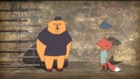
Brene Brown on Empathy vs Sympathy
https://www.youtube.com/watch?v=KZBTYViDPlQ
Sympathy: at least you have a marriage: Try to make things better
Empathy: I don’t know what to say right now, but I’m so glad you told me. A response rarely makes something better. What makes something better is connection
Notes:
Sympathy: at least you have a marriage: Try to make things better
Empathy: I don’t know what to say right now, but I’m so glad you told me. A response rarely makes something better. What makes something better is connection

Slide 6
‘A response rarely makes something better. What makes something better is connection.’
Brene Brown

Slide 7
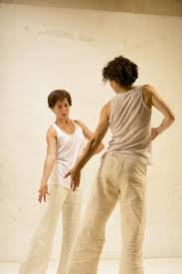
Moving together:
It’s nice to move together
But
In order for it to develop into a therapeutic relationship it requires attunement.

Slide 8
Kinaesthetic Empathy needs Attunement Joining in:
demeanor
Non-verbal expression
moving together
feeling/tone

Slide 9
Experiential:
Person A is sad
Person B approaches in a sympathetic and then a kinaesthetic empathic way
Swap.
Share your experience

