Slide 1
Dance Movement Therapy
NDIS Clients

Slide 2
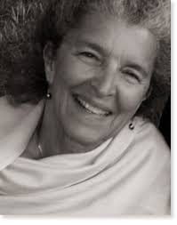
Mary Starks Whitehouse
Dance Movement Therapist

Slide 3
Her evolution toward dance movement therapy
From form to formless dance
From teaching dance to teaching people
From a focus on an art form to a focus on the process of human development
Joy, rhythm and energy is the heritage of every body.
Dance Movement brings awareness, connection and change

Slide 4
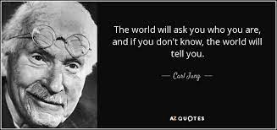
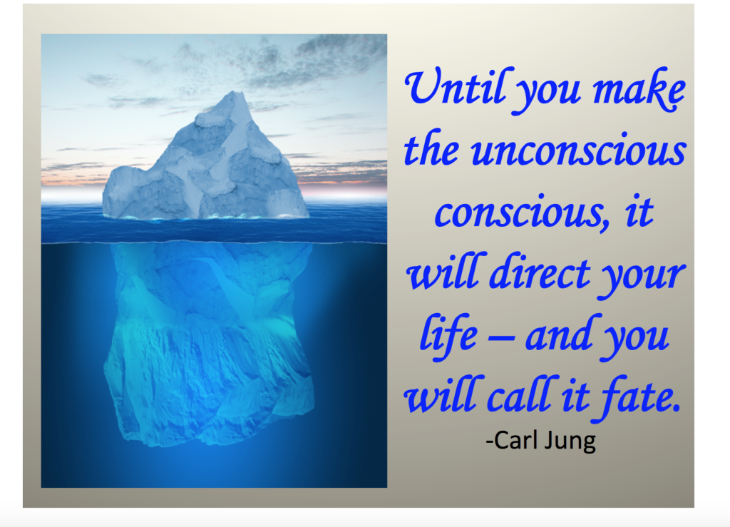
Depth Analysis The conscious mind makes sense of everyday experience. It is the tip of the iceberg of human experience. Below the surface is the unconscious. Becoming a whole person requires the capacity to access the realm of the unconscious. This is Self-Knowledge. Before that, the client may feel that something is missing, lacking… In a Jungian clinical psychological process, the analysand co-operates with the analyst to discover the living reality of the unconscious. This is done by becoming sensitive to symbols in the inner and outer world. For example, symbols in the realm of dreams, memories, reflections, behaviours and life events.

Slide 5
Active Imagination
‘A term used by Jung for a process in which, while consciousness looks on, participating but not directing, co-operating but not choosing, the unconscious is allowed to speak whatever and however it likes.’ pg 83
It can be expressed in imagery/symbols/sound
e.g.
painting sculpture poetry dance inner voices etc
It may come from a personal level and/or the collective, universal human connection.
Stimulus for Active Imagination may come from: fantasises, images and dreams, nature, somatic impulse
Insights in Active Imagination offer information, understanding and direction for everyday life.

Slide 6
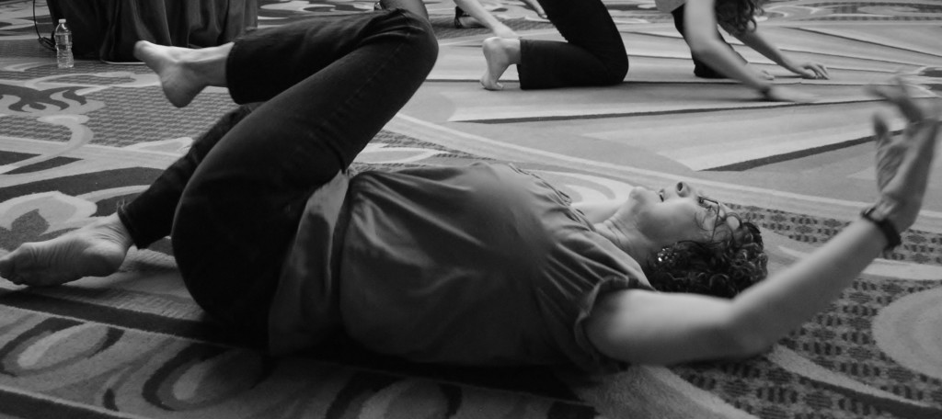
I move / I am moved
‘I move’ = I choose to move
‘I am moved’ = ‘Moving happens; the ego gives up control, stops choosing, stops exerting demands, allowing the self to take over moving the physical body as it will’ pg 82
Ultimate: Coming to a place where the inner witness can hold the simple conscious movements and the deepest, most poignant expressions surfacing from the unconscious.

Slide 7
Therapeutic Process
‘Relationships of leading and following… are as varied as the people concerned but the necessary attitudes are permissiveness and allowance on both sides….’ pg 85
1.: Start where the mover is at.
2. Be willing to wait, be silent for the mover to sink into quietness and find the impulse to move.
It is not a process of thinking things through.
Forego all ideas/assumptions of what is needed. The mover must follow her hunches/intuition. The more they’re trusted, the more strongly they come.
There is a moment when the mover transitions from conscious mode into the zone of the unconscious, expressed as active imagination. The witness can observe the shift if this is in her direct experience.

Slide 8
Dance Movement Therapy NDIS Clients

Slide 10
DMT’s working with NDIS Clients
https://dtaa.org.au/therapy/ndis-for-clients/

Slide 11
Installing Resources

